Slide 1
Excel Analytics
TT

Slide 2
Scenario Analysis

Slide 3
End Results

Slide 4
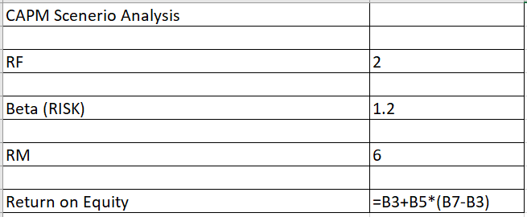
Step 1: Create the formula
Return on Equity = RF + Beta*(RM-RF)

Slide 5
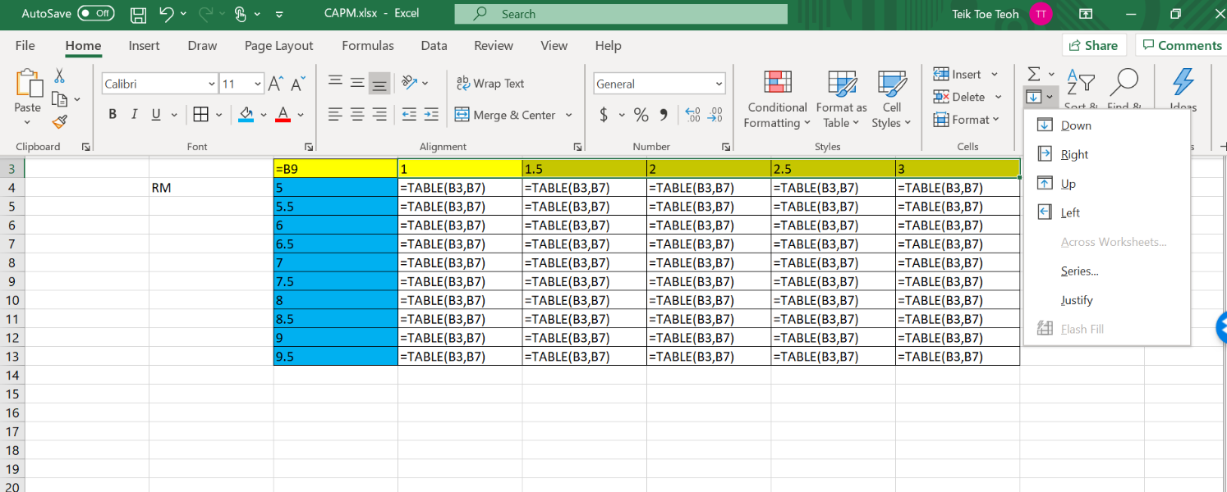
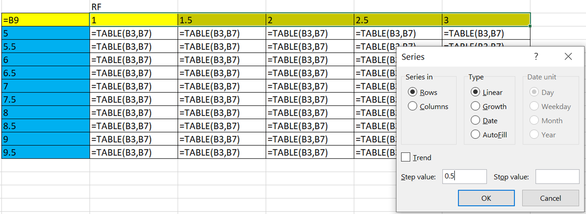
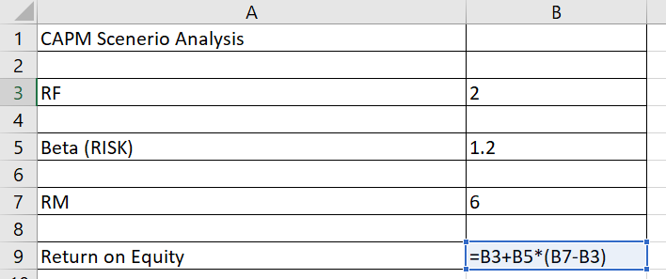
Step 2: Create the scenario using fill
Highlight

Slide 6
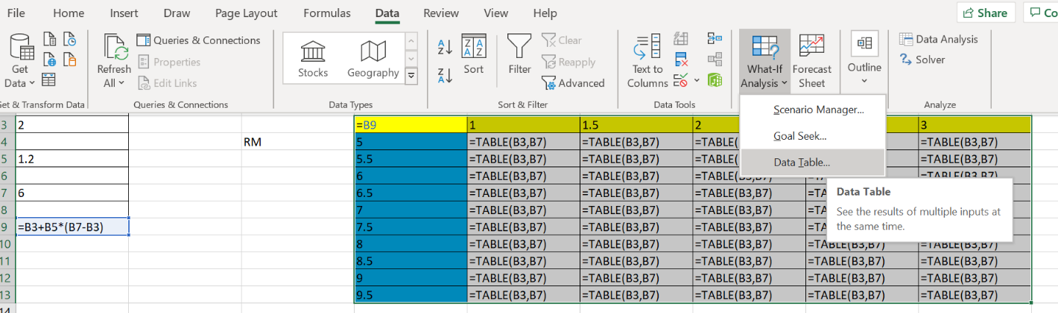
Step 3
Step 1: Highlight the table

Slide 7
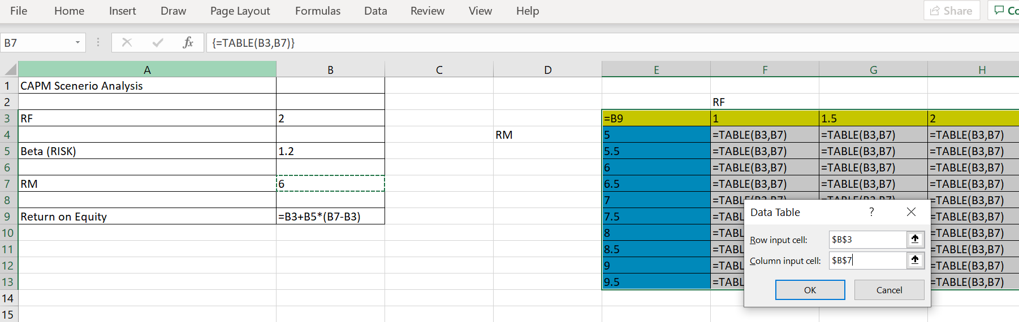
* Row input cell is RF (horizontal axis) and VV

Slide 8
Filter

Slide 9
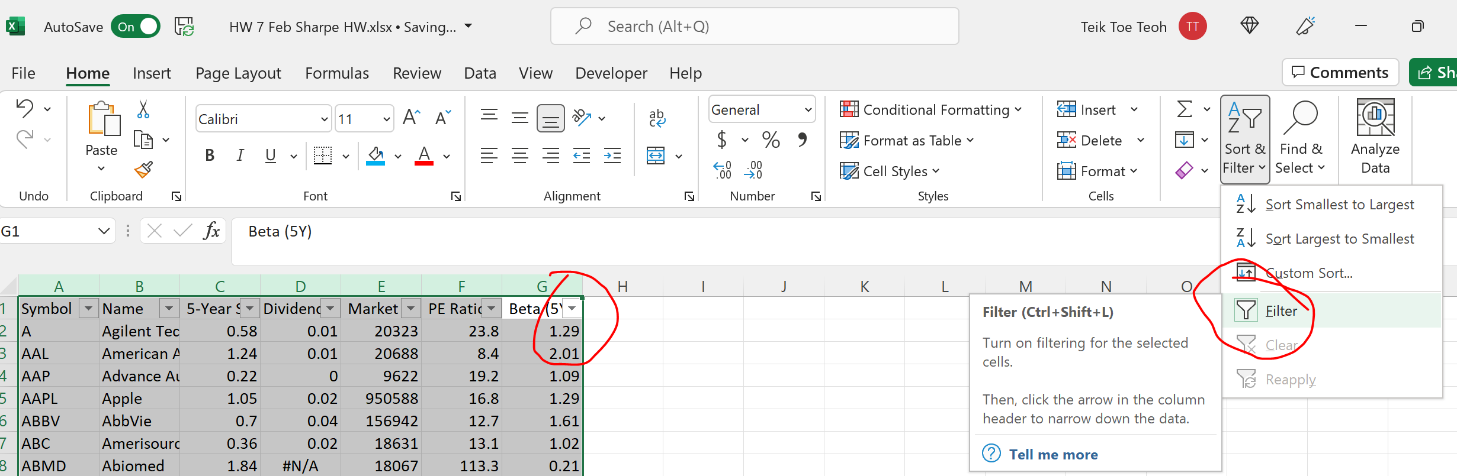

Slide 10
Pivot Table

Slide 11
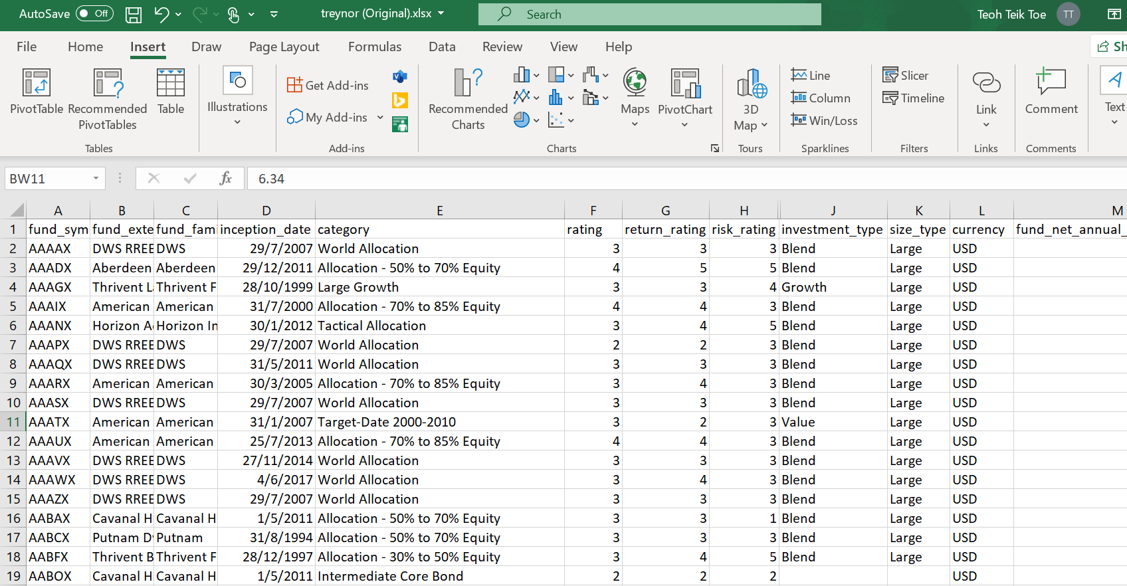
Pivot Table – Treynor Ratio

Slide 12
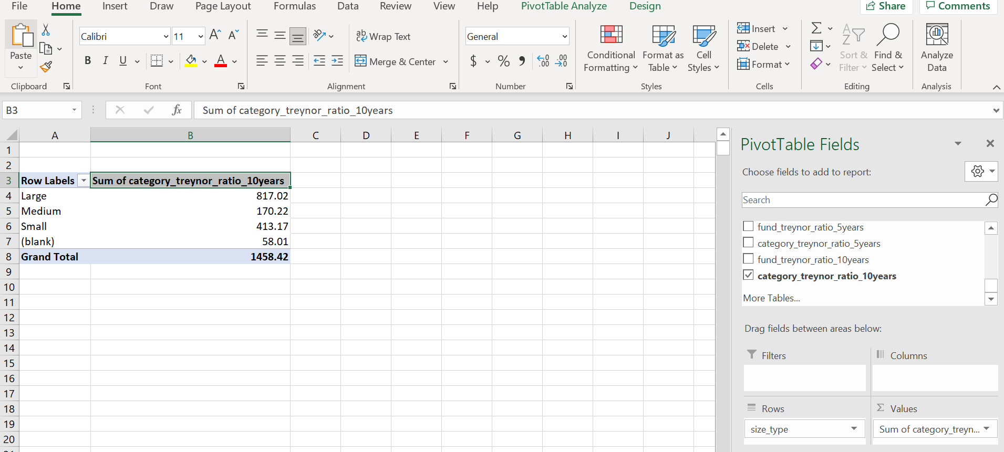

Slide 13
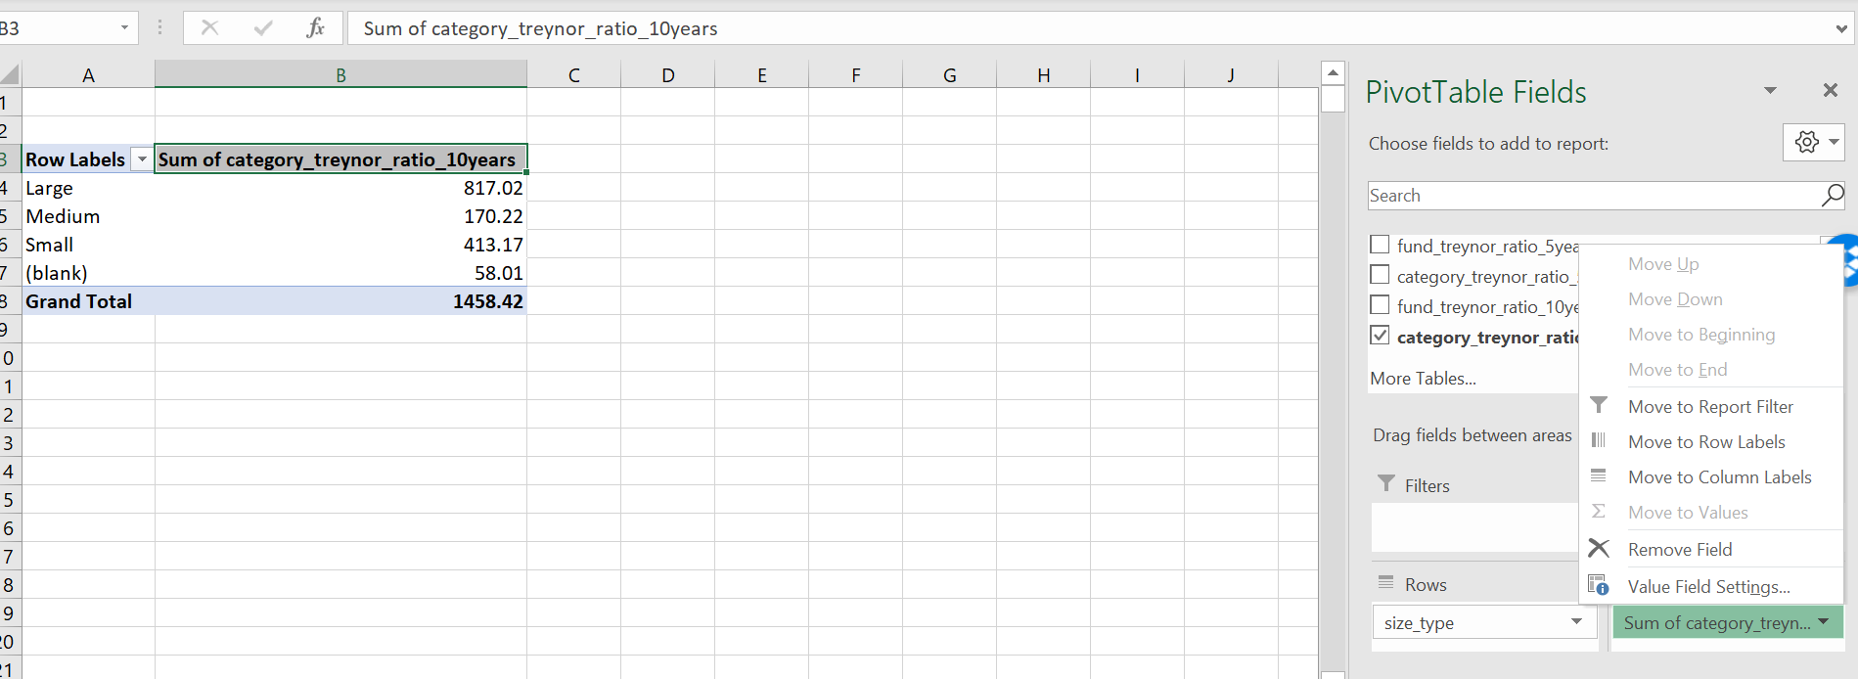

Slide 14
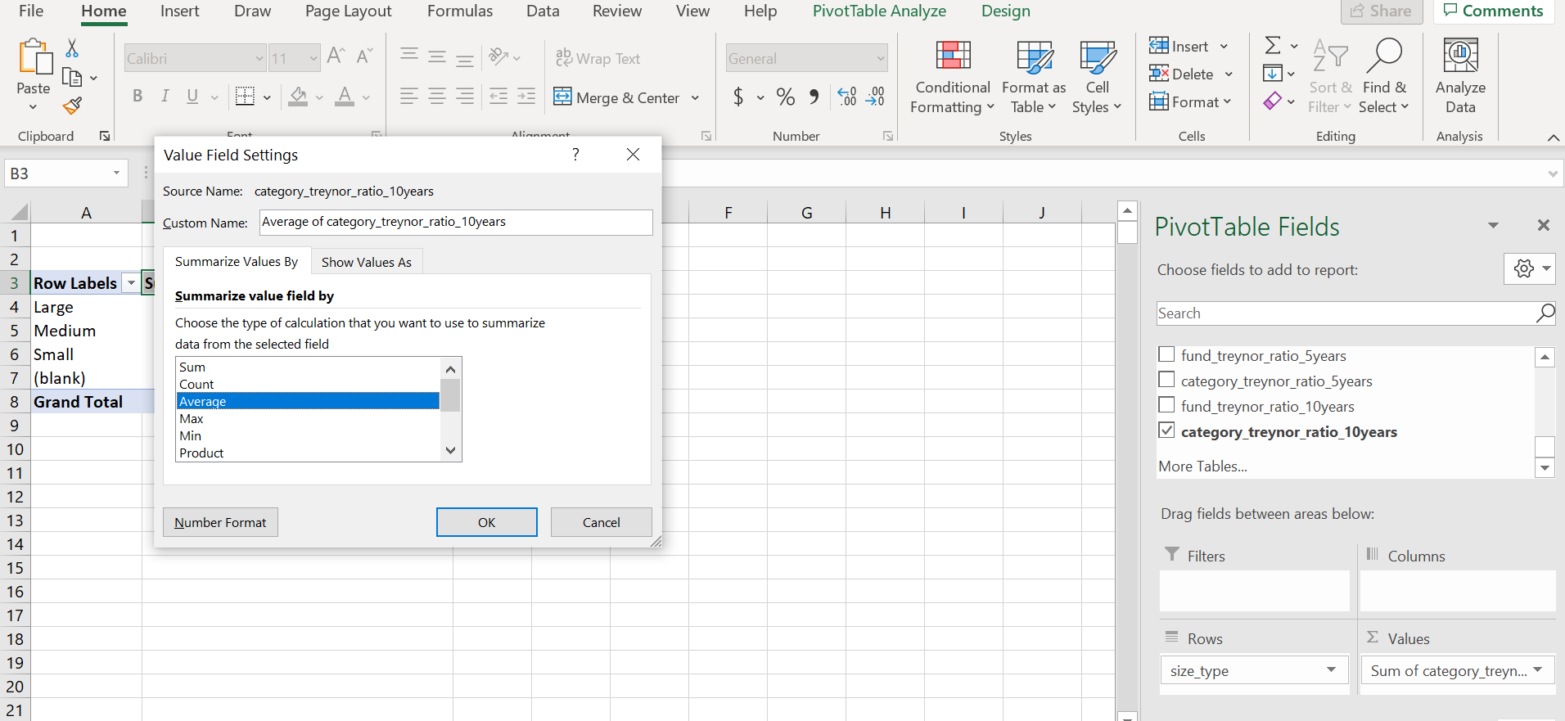

Slide 15
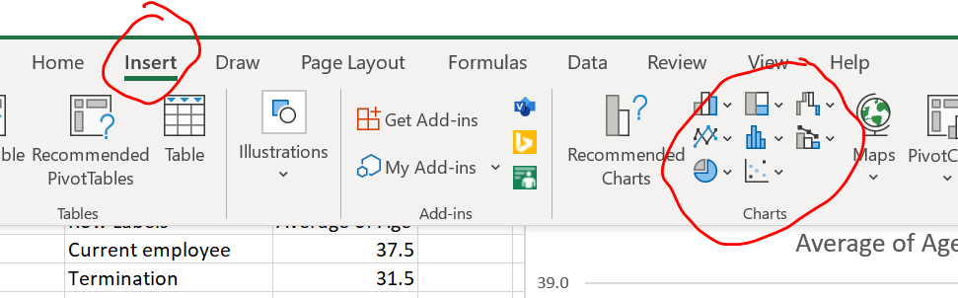
Visualization

Slide 16
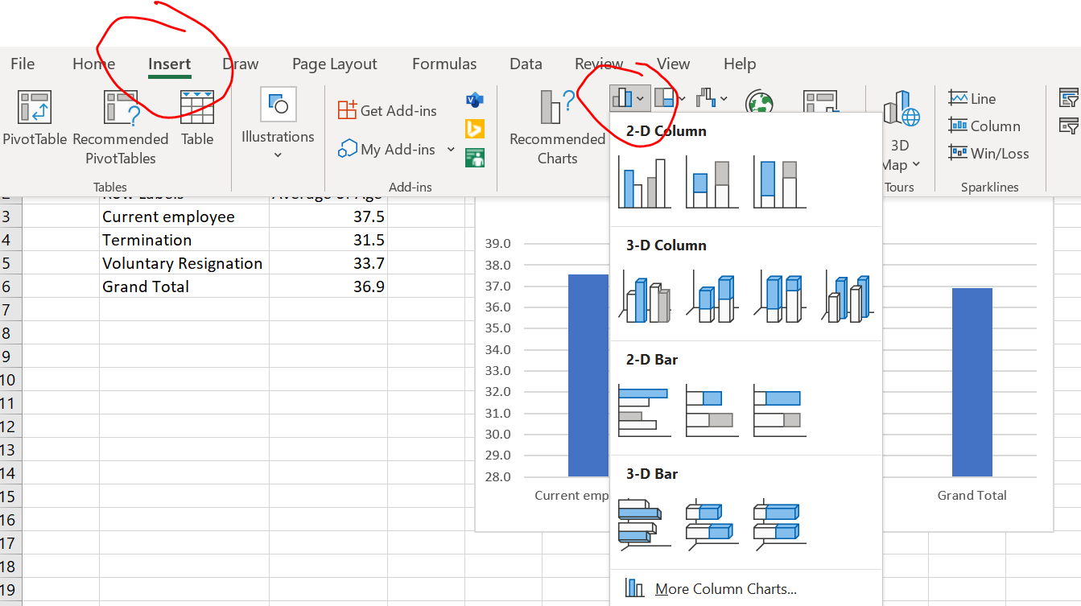
Insert Chart

Slide 17
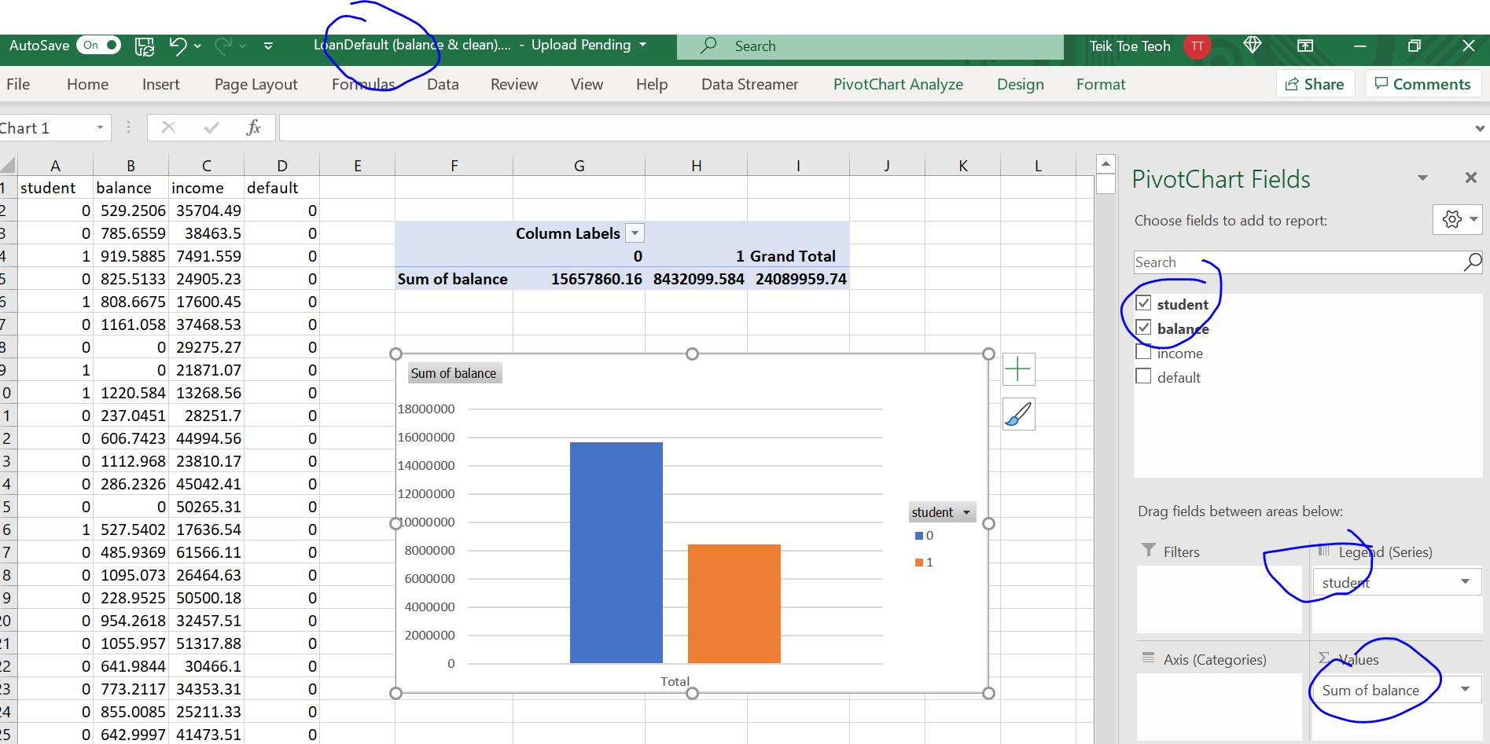
Pivot Chart

Slide 18
Data Analytics

Slide 19

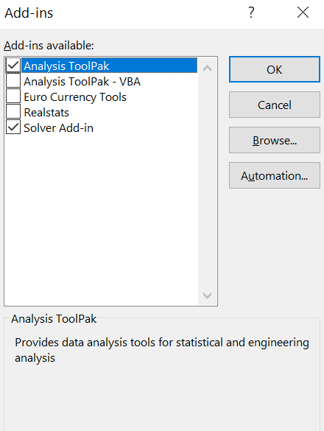
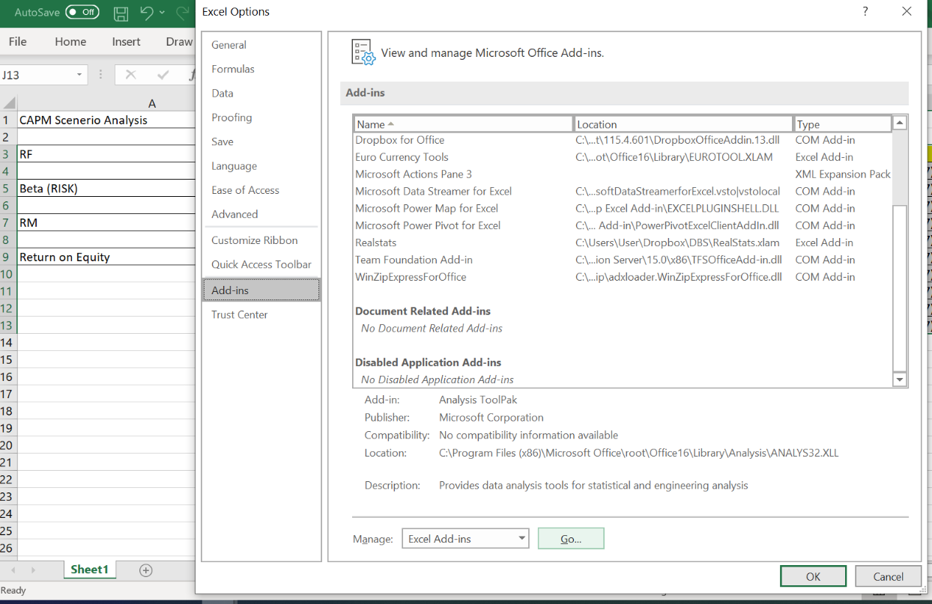
File -> Option -> Add-ins -> Manage -> Excel Add-ins - Go

Slide 20
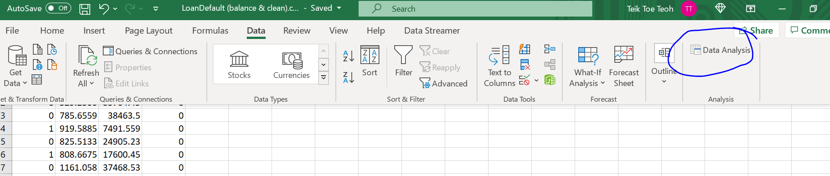
Regression on Loan Default

Slide 21
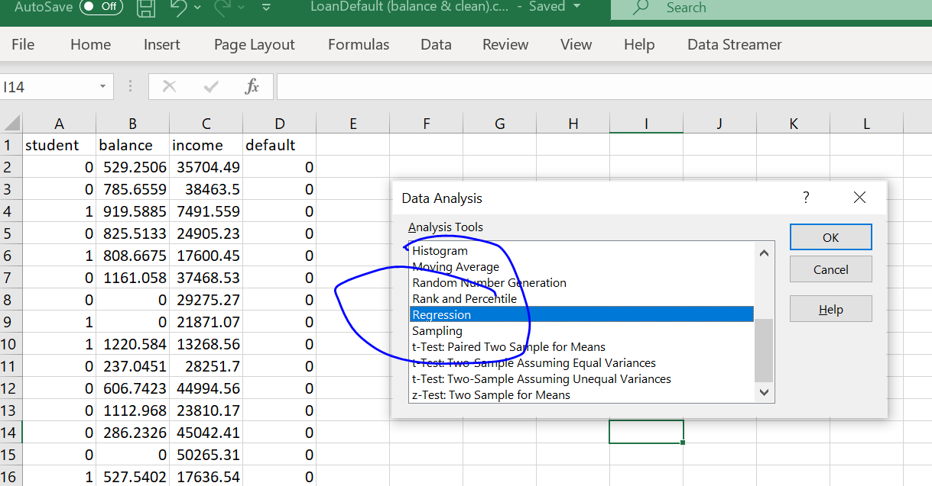

Slide 22
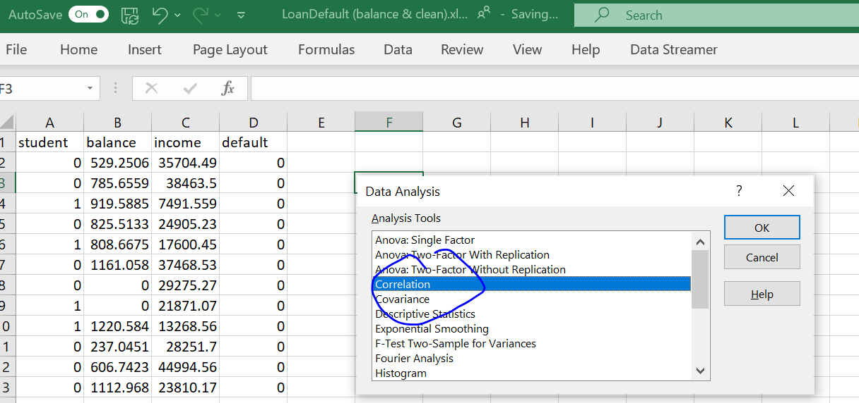
Correlation

Slide 23
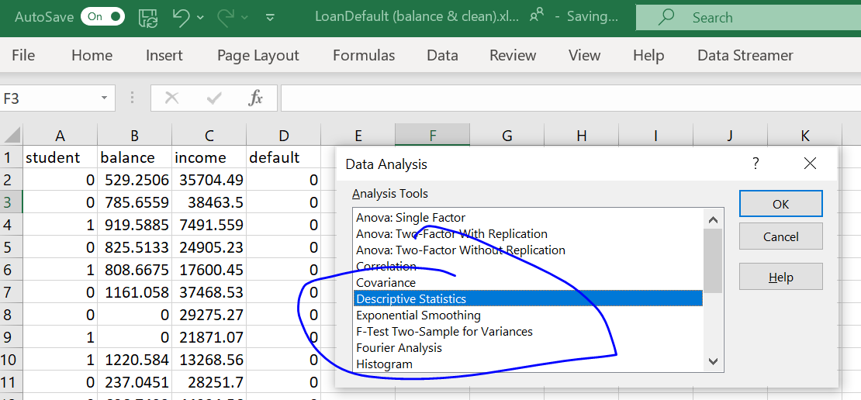
Statistic

Slide 24
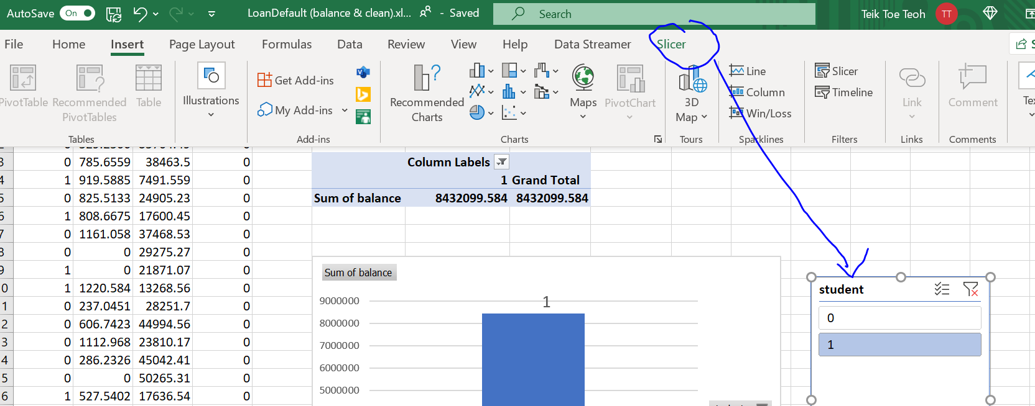
Slicer

